Slide 1

SONAR ROCK AND MINE PREDICTION
MACHINE LEARNING MODEL

Slide 2
OBJECTIVE
A machine learning project that has the potential to revolutionize submarine warfare. The goal of this project is to develop an accurate and reliable system for differentiating between rocks and mines in submarine environments.
The importance of this project cannot be overstated. Misidentification of rocks as mines can have catastrophic consequences, putting submarines and their crews at risk. By developing a machine learning solution to this challenge, we hope to significantly reduce the risk of accidents and improve the safety of submarines around the world.

Slide 3






WORK FLOW
Data
Data pre processing
Train Test split
ML Algorithms
Predication
New Data
Trained model

Slide 4
THE PROBLEM
Differentiating between rocks and mines in submarine environments is an incredibly difficult task. The underwater terrain is often cluttered with rocks and other debris, making it challenging to distinguish between natural formations and man-made objects. This is further complicated by the fact that mines can be designed to look like rocks, making them even harder to detect.
Misidentification of rocks as mines can have serious consequences. It can lead to accidental detonation of mines, which can cause significant damage to submarines and put their crews at risk. Therefore, it is crucial that we find a way to accurately identify mines in submarine environments.

Slide 5
Our machine learning solution to the challenge of identifying rocks and mines in submarine environments is based on a machine learning model. The system is trained using a dataset of sonar , which have been labeled as either rocks or mines. The machine learning is able to learn the distinguishing features of rocks and mines, and can accurately classify new data. This makes it an incredibly effective tool for identifying potential threats in submarine environments.
THE SOLUTION

Slide 6
ABOUT DATASET
COLUMNS
ROWS
61
208

Slide 7



TARGET
111
97
MINE
ROCK
TARGET VARIABLE

Slide 8
MODEL PERFORMANCE
ML MODEL | ACCURACY ON TEST
Logistic Regression | 76
Decision Tree | 71
Random Forest | 76

Slide 9
ACCURACY OF THE MODEL
In our experiments, we developed a logistic regression model for submarine rock vs mine prediction and evaluated its accuracy on a test dataset. The model achieved an accuracy of 76%, which is a significant improvement over traditional methods of underwater object identification.
This high level of accuracy demonstrates the potential of machine learning algorithms for improving the safety and effectiveness of naval operations. By using accurate prediction models, we can reduce the risk of misidentifying objects and improve the efficiency of underwater object detection and removal.

Slide 10
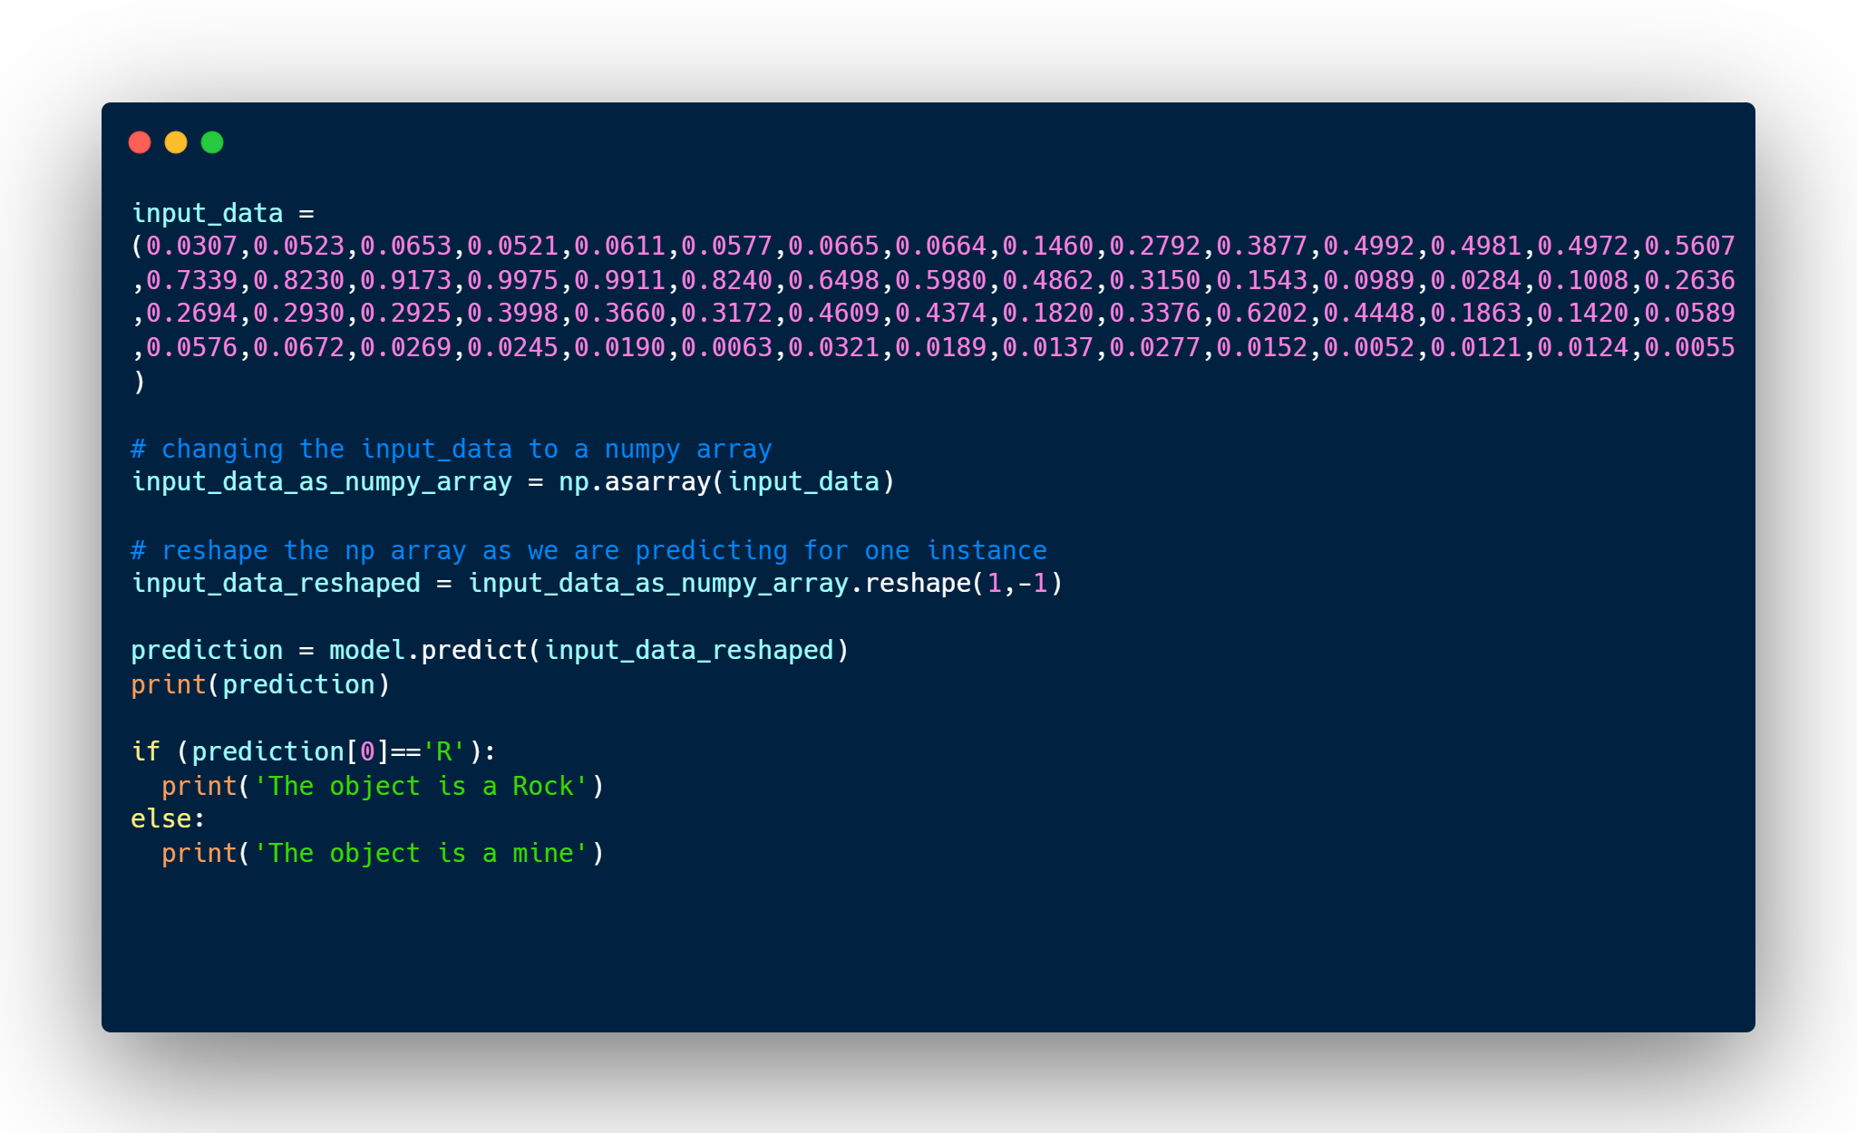
PREDICATION RESULT
Predication result :
['M’]
The object is a mine

Slide 11
CONCLUSION
Rock vs mine prediction is a critical task for naval operations, and accurate prediction models are essential for improving the safety and effectiveness of these operations. By using machine learning algorithms such as logistic regression, Decision Tree, Random Forest we can develop models that can accurately differentiate between rocks and mines.
Our experiments have shown that logistic regression models can achieve high levels of accuracy in rock vs mine prediction, demonstrating the potential of machine learning for improving underwater object detection and removal. We hope that our work will inspire further research in this area and lead to even more accurate and effective prediction models.

Slide 12
THANKS!
Do you have any questions?

